Slide 1
OBJECT ORIENTED JAVA PROGRAMMING 19CS3503
HOSPITAL MANAGEMENT SYSTEM
Team members :
B raj gautam – eng19cs0058
Banu s – eng19cs0060
Basava chethan – eng19cs0061
Bharath kumar n – eng19cs0064

Slide 2
PROBLEM STATEMENT
Since hospital is associated with the lives of common people and their day-to-day routines.
The manual handling of the record is time consuming and highly prone to error.
The purpose of this project is to maintain the day-to-day state of Managing Patients, Doctors, laboratory, Inpatient, Outpatient, Rooms, and Hospital Bills information.

Slide 3
tools and Technologies USED
Mysql database(Back end)
Jframe(front End)
Netbeans(IDE)
Core JAVA

Slide 4
Project Functionalities
Hospital Management System improves the visibility and transparency in the complete management process and in all records.
It helps in streamlining the accurate reporting with the help of updated and accurate records.
Hospital Management System improves the quality control on the products and services of the hospital.
It also improved the management visibility of hospital, all information, and data regarding the patient, doctor and medicine could be seen by any department easily.

Slide 5
Project Functionalities
Hospital Management System allows complete data of different departments to store in the same database.
It improves the time management because it allows getting access to any required data or information with one click. It also allows to add or update information within in few clicks.
Hospital Management System makes it easy to get access to the management system facilities for the authorized users and keep it safe from unauthorized users.

Slide 6
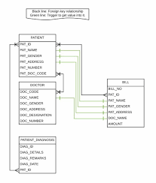
Data structure

Slide 7


